Slide 1
ANALYTICS FOR HOSPITALS' HEALTH-CARE DATA

Slide 2
INTRODUCTION
Today’s healthcare industries are moving from volume-based business into value-based business, which requires an overwork from doctors and nurses to be more productive and efficient.
This will improve healthcare practice, changing individual life style and driving them into longer life, prevent diseases, illnesses and infections.
This paper aims to proof that healthcare data analytics techniques are not efficient enough and suitable anymore these days in order to manage big data issue and improve healthcare data analytics due to the rapid growth and evolution of technology.
Moreover, it’s also aims to promise professionals of a better quality of medical results, as well as reduce time needed to analyze healthcare data by keeping systems up to-date and sorting medical data in a logical structure along with accessing and retrieving patient’s historical data fast and smoothly. Stakeholder 2 Doctors and nurses.

Slide 3
PURPOSE
Data analytics in health care is vital. It helps health care organizations to evaluate and develop practitioners, detect anomalies in scans and predict outbreaks in illness, per the Harvard Business School.
Data analytics can also lower costs for health care organizations and boost business intelligence.

Slide 4
LITERATURE SURVEY
TITLE: Data-Driven Methods for Typical Treatment Pattern Mining
DESCRIPTION:
A huge volume of digitized clinical data is generated and accumulated rapidly since the widespread adoption of Electronic Medical Records (EMRs). This paper discusses the research background - big data analytics in healthcare, the research framework of big data analytics in healthcare, analysis of medical process, and treatment pattern mining. Then the challenges for data-driven typical treatment pattern mining are highlighted, including similarity measure between treatment records, typical treatment pattern extraction, evaluation and recommendation, when considering medical information in EMRs. Furthermore, three categories of typical treatment patterns are mined from doctor order content, duration, and sequence view respectively, which can provide a data-driven guideline to achieve the “5R” goal for rational drug use and clinical pathways.

Slide 5
TITLE: A Systematic Mapping Study
DESCRIPTION:
The current study performs a systematic literature review (SLR) to synthesise prior research on the applicability of big data analytics (BDA) in healthcare. The SLR examines the outcomes of 41 studies, and presents them in a comprehensive framework. The findings from this study suggest that applications of BDA in healthcare can be observed from five perspectives, namely, health awareness among the general public, interactions among stakeholders in the healthcare ecosystem, hospital management practices, treatment of specific medical conditions, and technology in healthcare service delivery. This SLR recommends actionable future research agendas for scholars and valuable implications for theory and practice.

Slide 6
TITLE: Exploring big data analytics in health care.
DESCRIPTION:
Cost optimization is one of the major issues in health care as it has become very difficult in fetching patient’s information across huge data bases. Here, various data mining techniques such as SVM, Decision Trees etc. have been discussed in order to address various healthcare issues. Later on Big Data Analytics tools were addressed on top of data mining techniques in health care sector, as the health care industry is one of the leading sectors where huge revenue will be generated across globe as the numbers of patients are increasing drastically with the population. In future Machine learning with Big Data has lot of scope in healthcare as so many new diseases are coming into lie light across the world.

Slide 7
TITLE: Big Data Analytics Framework for Opinion Mining of Patient Health Care Experience
DESCRIPTION:
Preciously administration might be able to acknowledge the crucial decision-making process where the new investigations would be accounted for different research avenues.

Slide 8
TITLE: A systematic review of health care big data.
DESCRIPTION:
Analyzing different perspectives about the concept of big data in healthcare Exploring the origins of healthcare big data Identifying tools and techniques for healthcare big data Analytics.

Slide 9
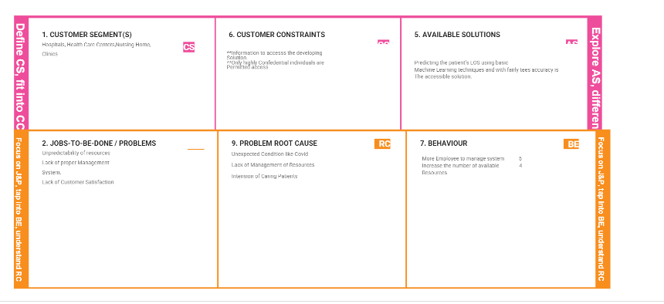
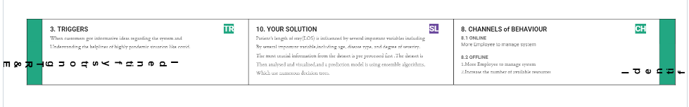
PROBLEM STATEMENT DEFINITION

Slide 10
EMPATHY MAP CANVAS
An empathy map is a simple, easy-to-digest visual that captures knowledge about a user’s behaviors and attitudes. It is a useful tool to helps teams better understand their users. Creating an effective solution requires understanding the true problem and the person who is experiencing it.
The exercise of creating the map helps participants consider things from the user’s perspective along with his or her goals and challenges.

Slide 11
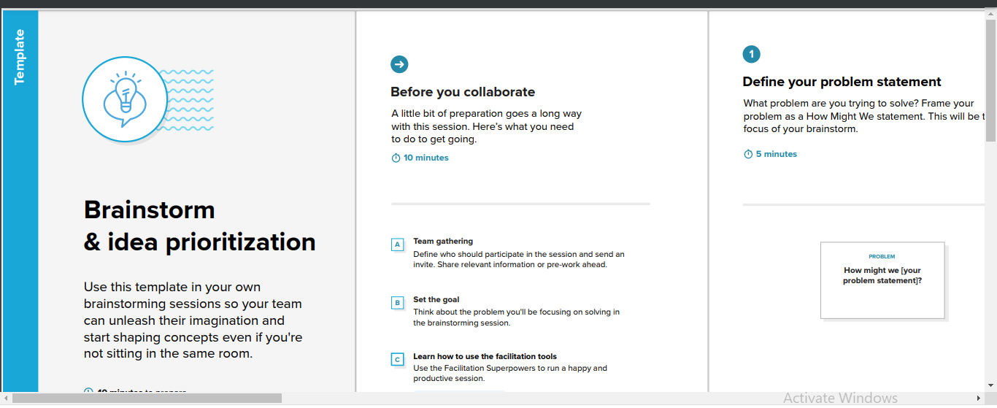
IDEATION & BRAINSTORMING

Slide 12
PROPOSED SYSTEM
S.NO. | PARAMETER | DESCRIPTION
1. | Problem Statement (Problem to be solved) | To precisely determine the patient’s length of Hospital stay
2. | Idea / Solution description | Gather patient data from medical facilities Examining the specifies of the patient’s documents Create a Cognos Analytics dashboard to show Patient data
3. | Novelty / Uniqueness | Accurate understanding of the factors associating with the LOS and progressive improvements in processing and monitoring may allow more efficient management of the LOS inpatients.

Slide 13
S.NO. | PARAMETER | DESCRIPTION
4. | Social Impact / Customer Satisfaction | A shorter LOS reduces the risk of acquiring staph infections and other healthcare-related conditions, frees up vital bed spaces, and cuts overall medical expences.
5. | Business Model (Revenue Model) | The length of stay LOS is an important indicator of the efficiency of hospital management.Reduction in the number of inpatients days results in decreased risk of infection and medication side effects,improvement in the quality of treatment, and increased hospital profit with more efficient bed management.
6. | Scalability of the Solution | Remote patient monitoring systems enabling effective distance treatment. Patient portals that allow people to better manage their health themselves.

Slide 14
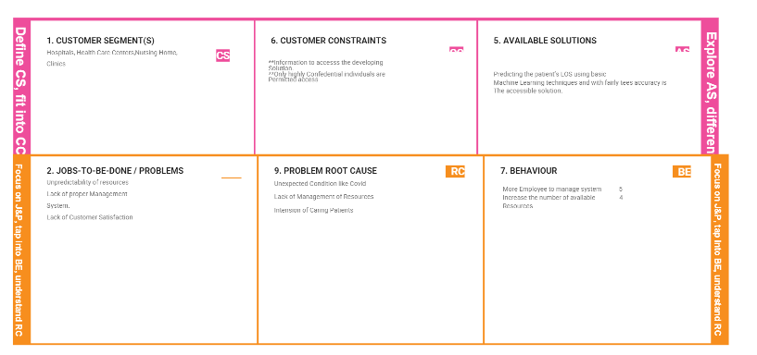
PROBLEM SOLUTION FIT

Slide 15
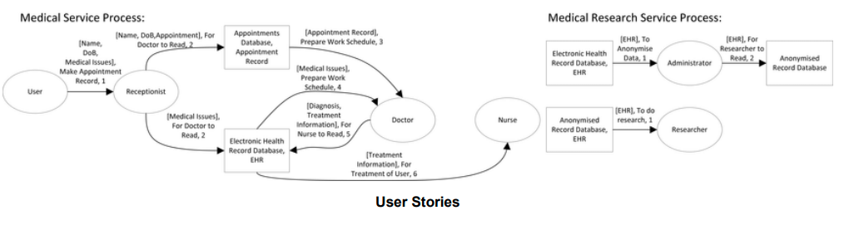
DATA FLOW DIAGRAM
A Data Flow Diagram (DFD) is a traditional visual representation of the information flows within a system. A neat and clear DFD can depict the right amount of the system requirement graphically. It shows how data centers and leaves the system, what changes the information, and where data is stored.

Slide 16
SOLUTION ARCHITECTURE
Solution architecture is a complex process – with many sub-processes – that bridges the gap between business problems and technology solutions. Its goals are to:
Find the best tech solution to solve existing business problems.
Describe the structure, characteristics, behavior, and other aspects of the software to project stakeholders.
Define features, development phases, and solution requirements.
Provide specifications according to which the solution is defined, managed, and delivered.

Slide 17
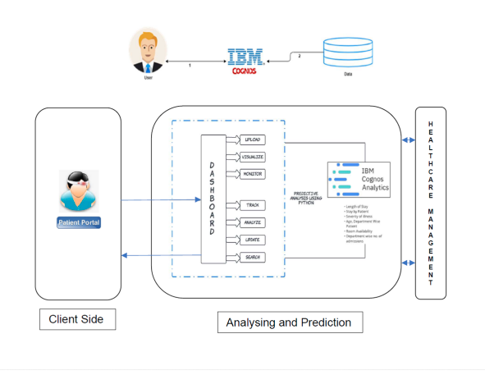
SOLUTION ARCHITECTURE

Slide 18
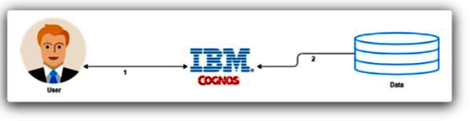
TECHNICAL ARCHITECTURE

Slide 19
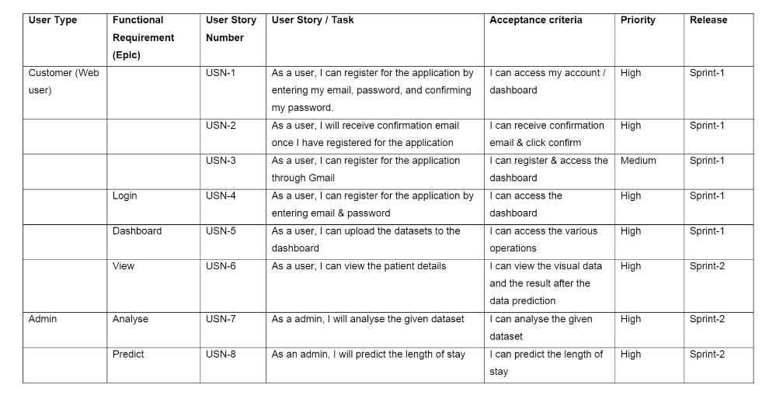
USER STORIES

Slide 20
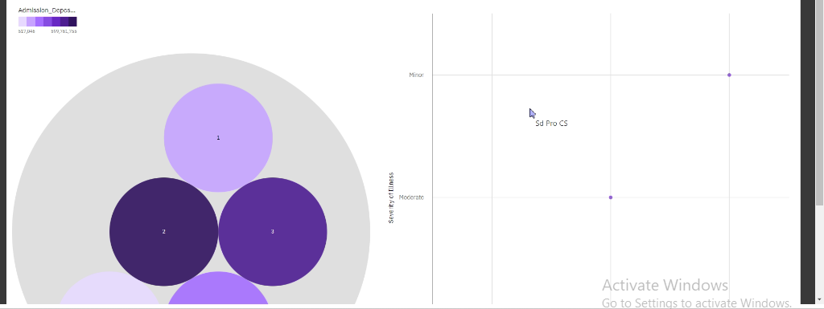
RESULTS

Slide 21
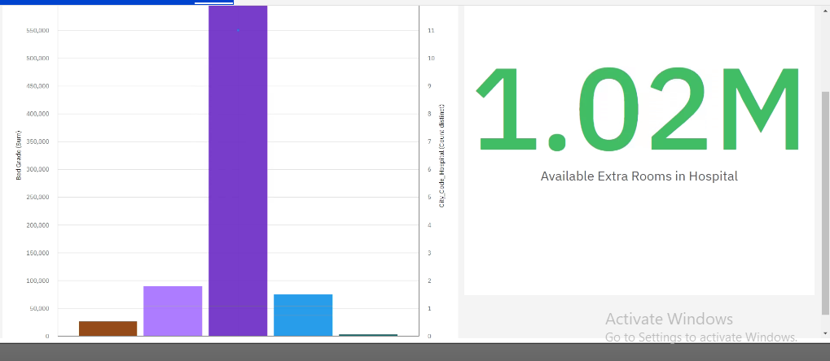
ANALYTICAL RESULT

Slide 22
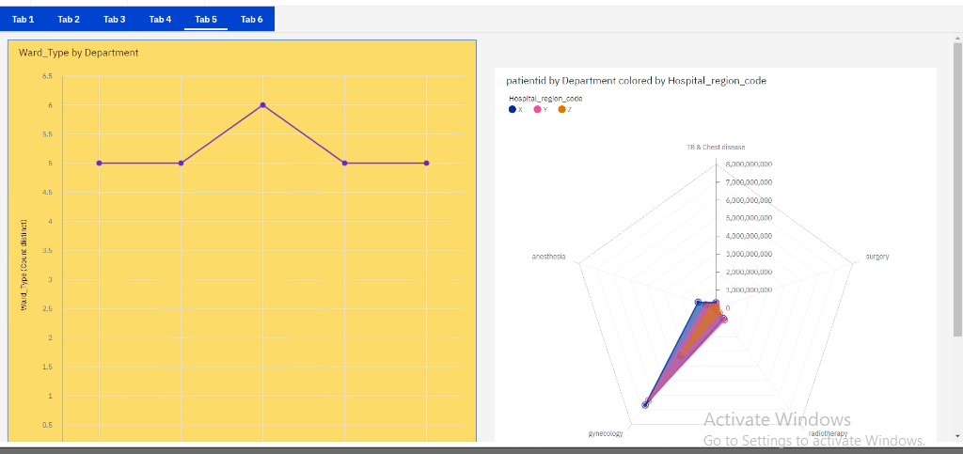
PATIENT ANALYTICAL RESULTS VIEW

Slide 23
CONCLUSION
A COVID-19 Analytics Agenda HDMS recognized the opportunity to leverage our clinical and analytic experts to offer content to support companies that extend even beyond our own client base.
We created an Analytics Agenda and shared supporting resources to best leverage health analytics to support your organization A massive amount of data in various forms needs to be handled for any healthcare application and data type, data size and other features are significant in data handling. With the growth of big data in biomedical and healthcare communities, accurate analysis of medical data has the benefits of early disease detection, improved patient care, and effective community services.

Slide 24
ADVANTAGES AND DISADVANTAGE
Its Can Provide The Facility Of Covid Patient Details
Organization-Wide Assessment Of Current Conditions
We Can Provide The Analytical Results
Its Only Analytical Result
Its not user friendly

Slide 25
REFERENCES
Abbott, PA & Coenen, A 2008, 'Globalization and advances in information and communication technologies: The impact on nursing and health', Nursing Outlook, vol. 56, no. 5, pp 238- 246.
Al-Azzawi, H. 2014. “Caradigm healthcare analytics.” http://www.caradigm.com/media/68911/CaradigmWP-Healthcare-Analytics-Jan-2014-US-EN.PDF Retrieved 09 August, 2015.
Bakshi, K. 2014, ‘Considerations for big data: architecture and approaches’, Aerospace conference, IEEE, pp. 1-7.
Bertsimas, D; Bjarnadóttir, M; Kryder, J; Pandey, R; Vempala, S; Wang, G. (2008), ‘Algorithmic prediction of health-care costs’, Operations Research, vol. 56, no. 6, pp. 1382-1557.
Beyer, K., Ercegovac, V., Gemulla, R., Balmin, A., Eltabakh, M., Ozcan, F. and Shekita, E. 2011. “Jaql: A Scripting Language for Large Scale Semi-Structured Data Analysis.” http://web.cs.wpi.edu/~meltabakh/Publications/Jaql-PVLDB2011.pdf Retrieved 09 August, 2015.

